Slide 1
HOW TO DOWNLOAD AND INSTALL INTELLIJ IDEA
Presented To: Prof. JAANIS PEKSA
Presented By:
AJWIN JOJU VENNATTUPARAMBIL – CSA1D1

Slide 2

WHAT IS INTELLIJ IDEA?
IntelliJ IDEA is an Integrated Development Environment (IDE) developed by JetBrains.
Supports Java, Kotlin, Python, JavaScript, and many other languages.
Comes in Community (Free) and Ultimate (Paid) editions.

Slide 3

HOW TO DOWNLOAD INTELLIJ IDEA
Go to https://www.jetbrains.com/idea
Click Download
Choose your Operating System (Windows, macOS, or Linux)
Select Community Edition (for free use)
Wait for the installer to download

Slide 4
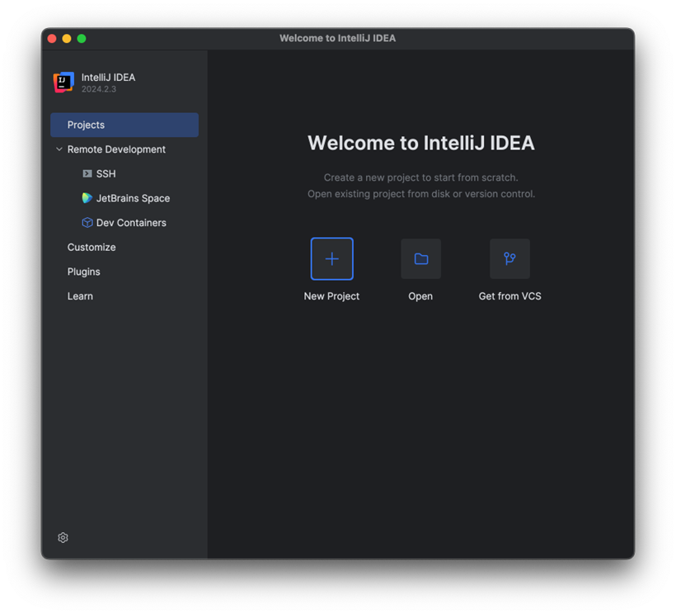
HOW TO INSTALL INTELLIJ IDEA
Open the downloaded (exe file)
Follow the installation wizard
Select installation options (e.g., 64-bit launcher, PATH variable)
Click Install and wait
Launch IntelliJ IDEA after installation

Slide 5
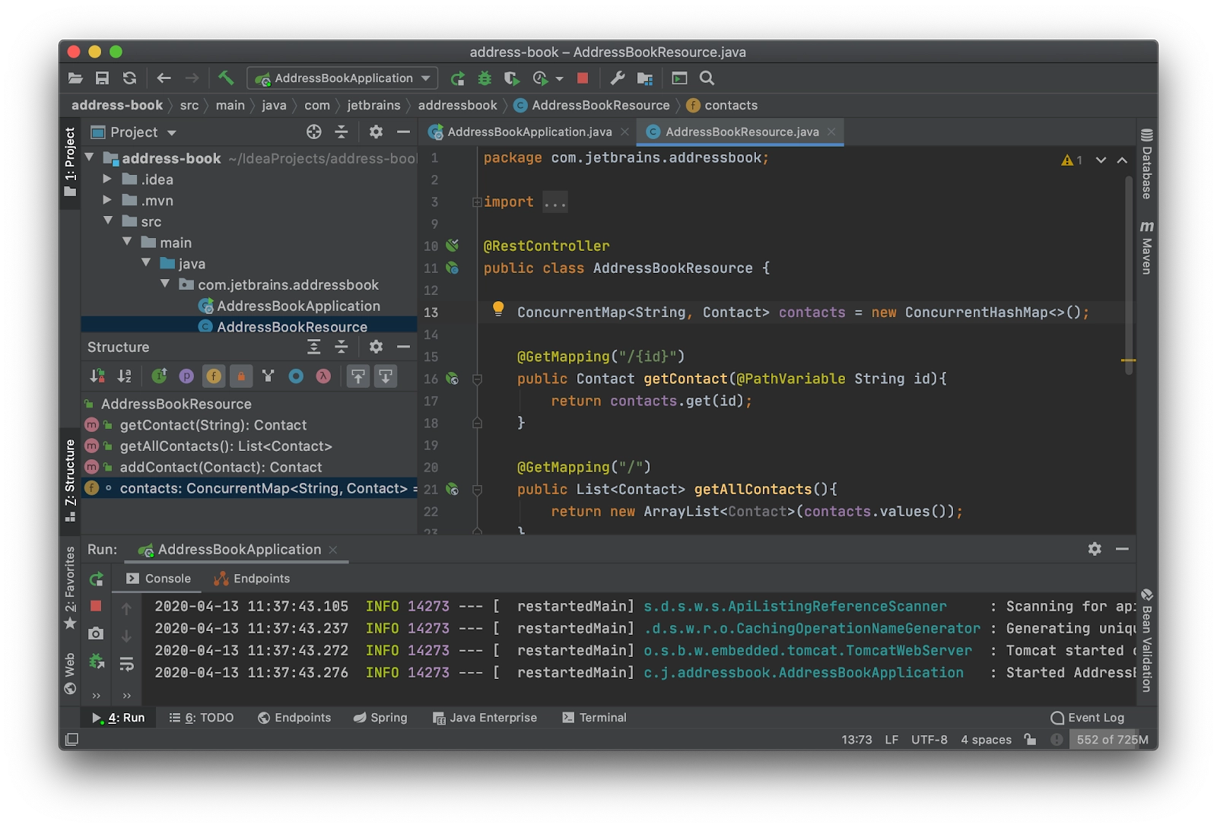
SETUP AND FIRST RUN
Choose UI theme (Light/Dark)
Configure plugins and JDK
Create or open your first project
INTELLIJ IDEA IS READY TO USE!

Slide 6
CONCLUSION
· IntelliJ IDEA provides a seamless process for users to download, install, and begin working on their development projects.
· A proper installation and initial setup ensures a smooth and efficient workflow for developers working with multiple programming languages and frameworks

Slide 7
THANK YOU

